Slide 1
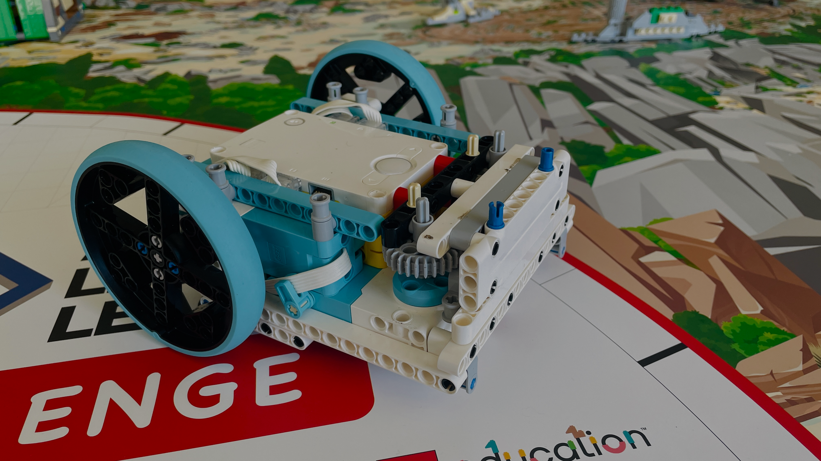








By Lebob 2025
Robot Design

Slide 2


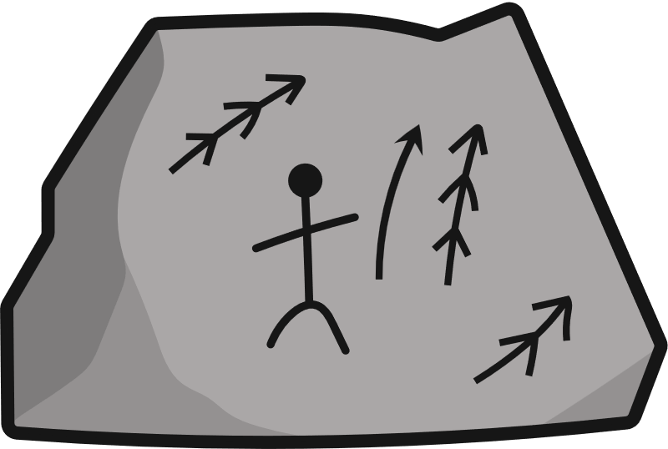

Which Lebob are You?
Kingsley Sean Oliver
Subesh Andre Chris
Aaron Leven

Slide 3
Part 1
Strategy

Slide 4
Our Game Plan
Consideration: Looking at the mission, we thought about ways they could be done as a team.
Plan: During a whole team meeting, we decided what missions we should do. We drew down some routes which we could follow.
Benefits: This optimised designing so we knew what each mechanism should do.
Action: After the planning was finished, we started making the mechanism and coding.
See page 5-7 of the Robot Design file
Notes:
While coding our missions, we realised that some missions were quite difficult to complete. So, we did some research on the missions so we could construct the routes for our mission plan.
This helped us a lot because we only had 4 before we decided on which route to take and the missions we would do.
It was beneficial as it allowed us to begin coding for our route with an exact idea of what needed to be completed within each run.

Slide 5
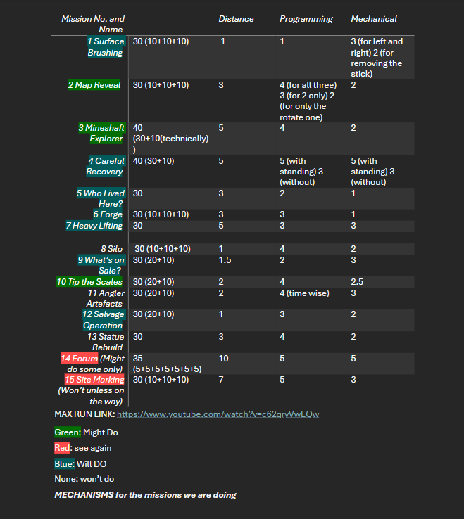
Missions Ranking
We decided on what missions we did.
This is process we went though:
List all the missions in a table. This helped us to compare missions.
Colour code the missions. We ranked them (based on location, mechanical difficulty and programming difficulty). See the key at the bottom.
e.g. We decided not to do site marking as it was too far.
See page 4-5 of the Robot Design file
Notes:
To decide on the missions we would do, we held a team meeting to have a brainstorm, writing all our decisions on our journal.
We colour coded each mission to show our decisions.
We ranked each one depending on:
Location
Mechanical Difficulty
Programming Difficulty

Slide 6
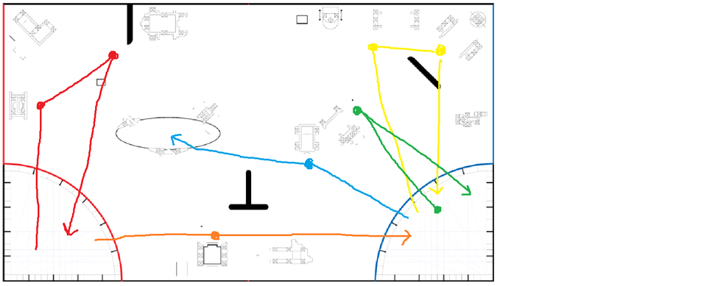
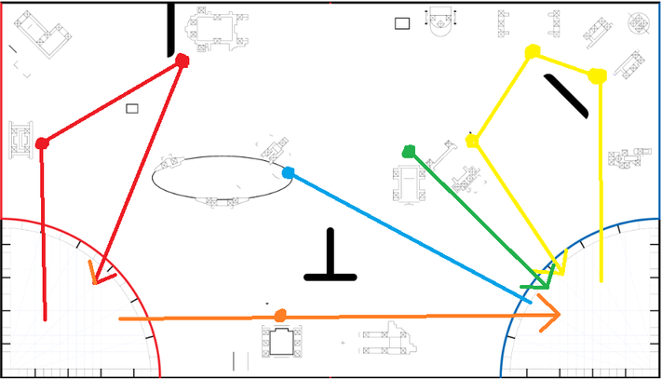
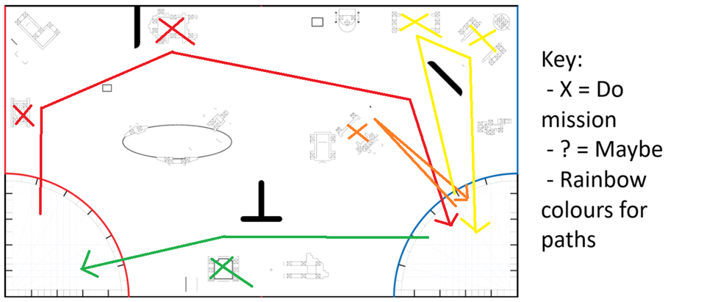
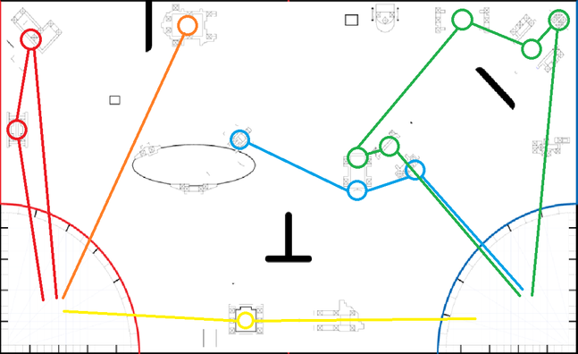
Game Plans
Version 1
Regionals
After ranking them, we all came together to make a full run and came up with these versions.
Version 2
Current
See page 5-7 of the Robot Design file

Slide 7
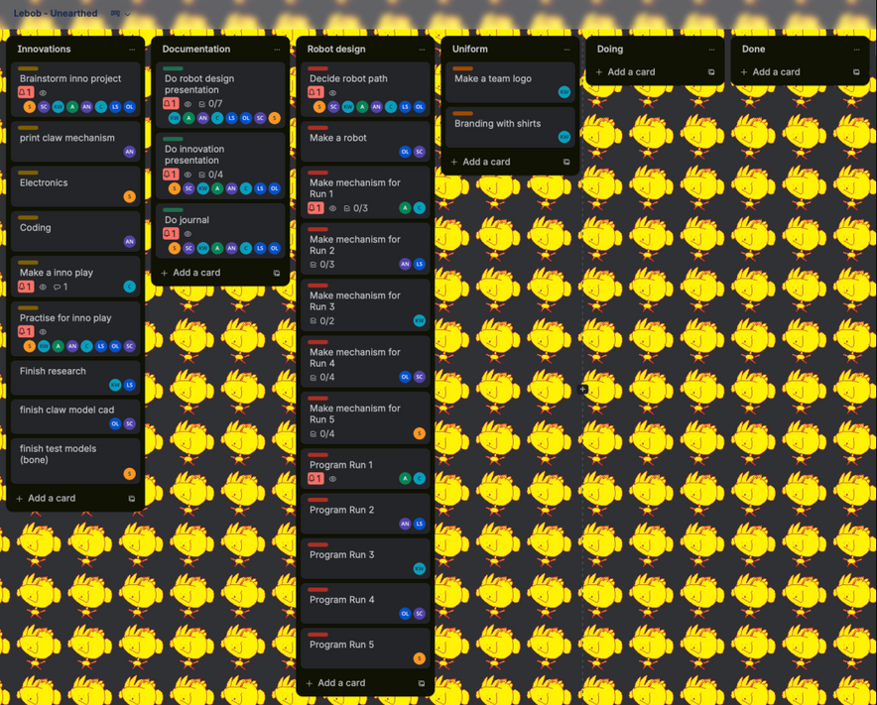
Project Plan - Trello
Trello is a website that allows our team to assign jobs to people and help us organise our jobs so that everyone can do things.
A timeline of our trello is in the documentation.
See page 11-13 of the Documentation file

Slide 8
Part 2
Robot

Slide 9
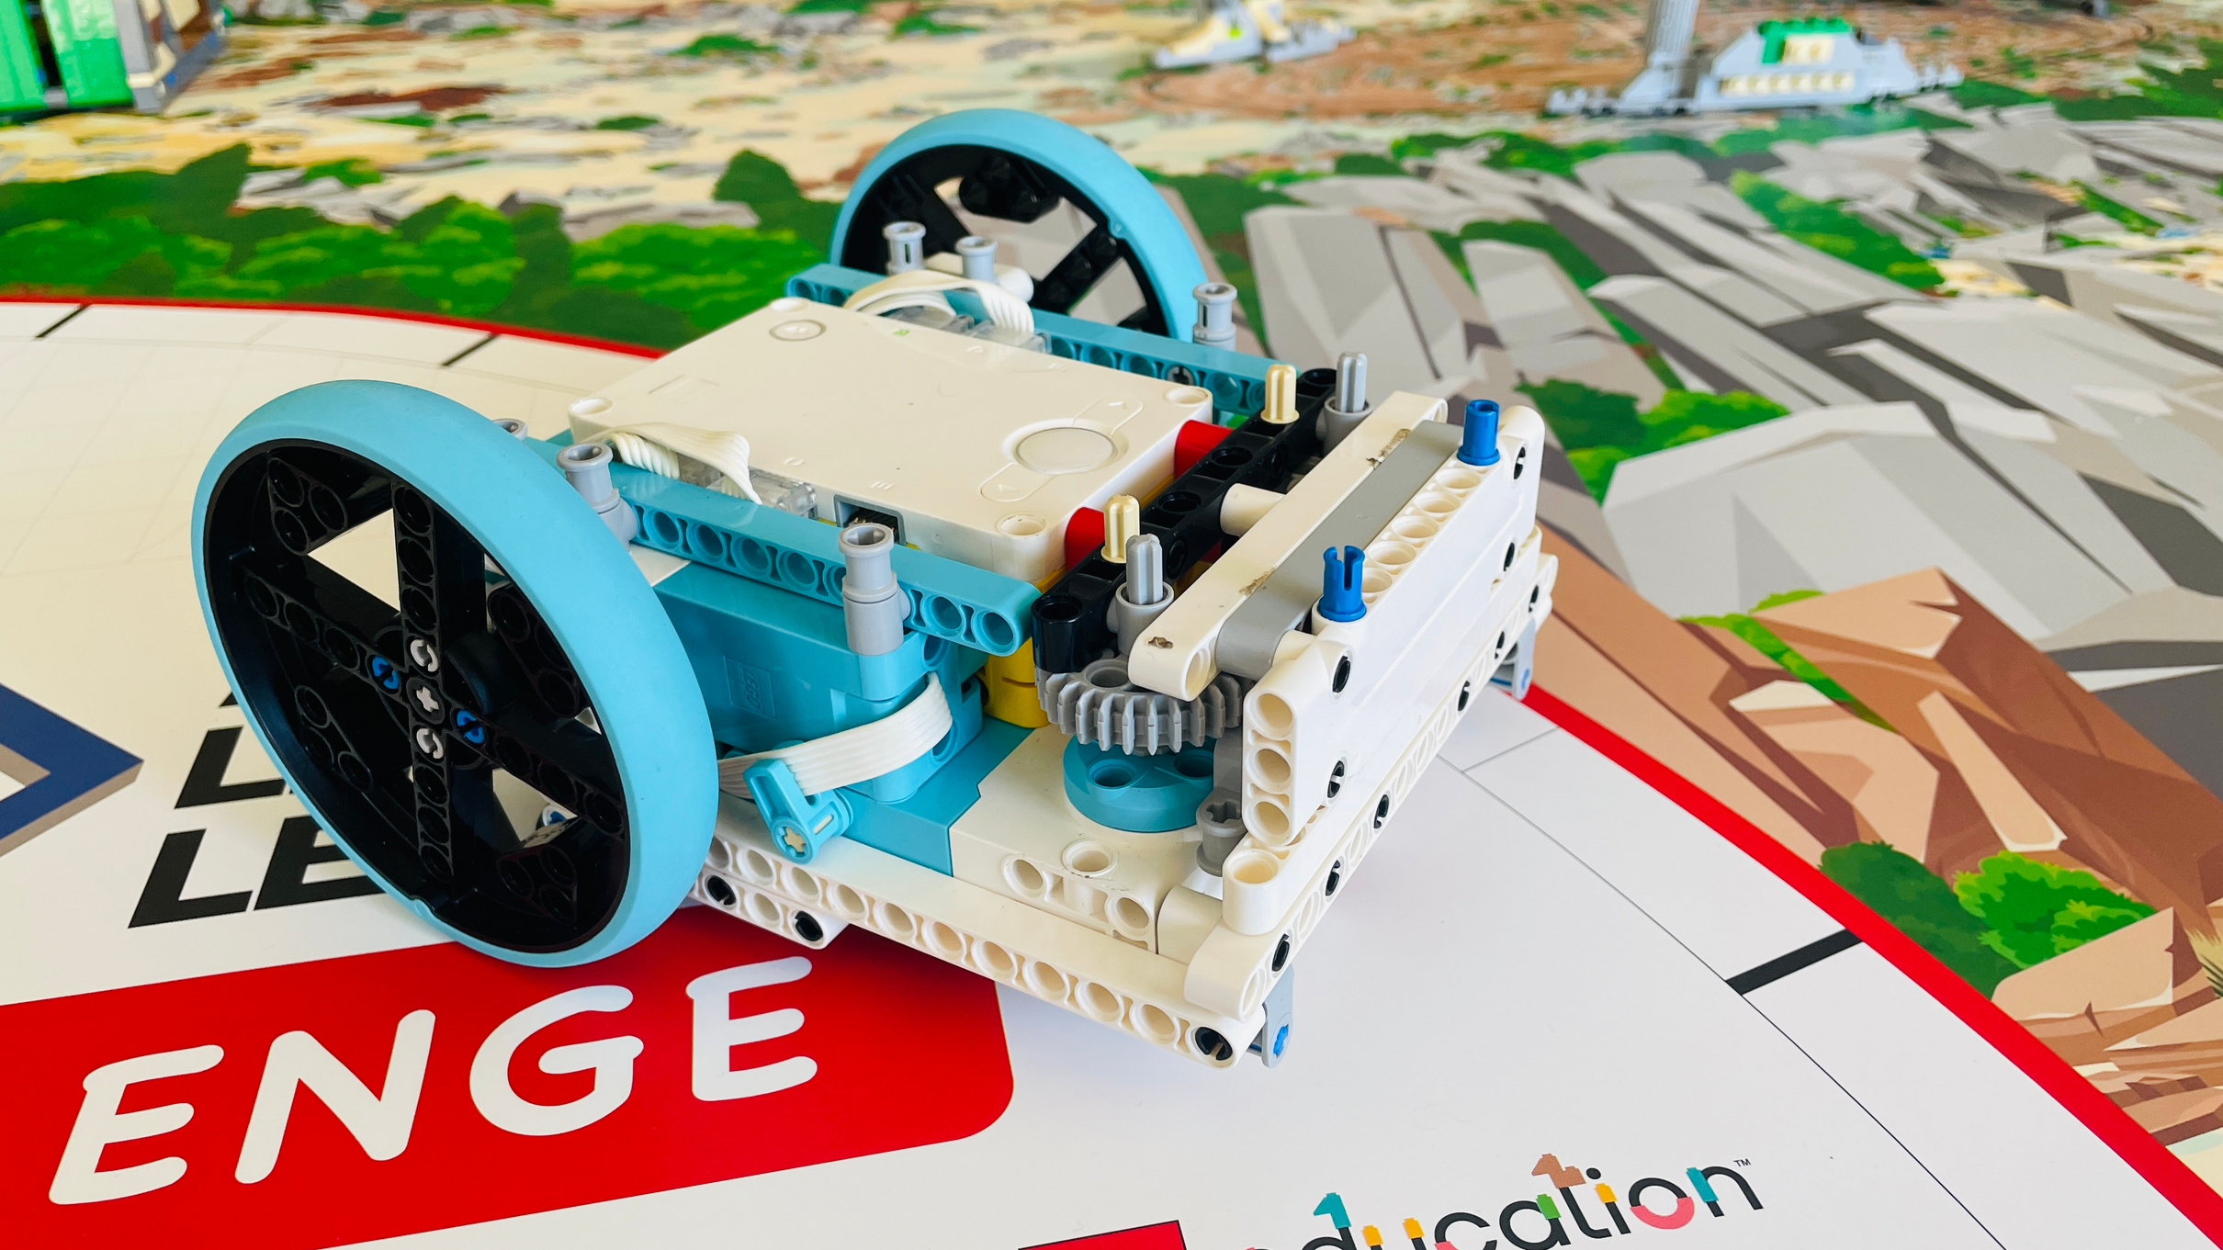
Our Robot Design
Movement:
2 medium motors - wheels
1 caster ball for balance
Attachments:
2 large motors with gears
Features:
Low centre of gravity
No hanging cables
See page 7 of the Robot Design file

Slide 10
Issues & Fixes
Issue: The centre of gravity of the robot was too high. Effect: Inaccuracies in movement as the robot swayed when moving.
Fix: Moved the heavy motors and hub down lower.
Issue: Gears were not connected well.
Effect: Attachments on gears slipped, didn’t turn well.
Fix: Added pieces to pin down the gears and attachments. Reduced gear slippage.
See page 10 of the Robot Design file

Slide 11
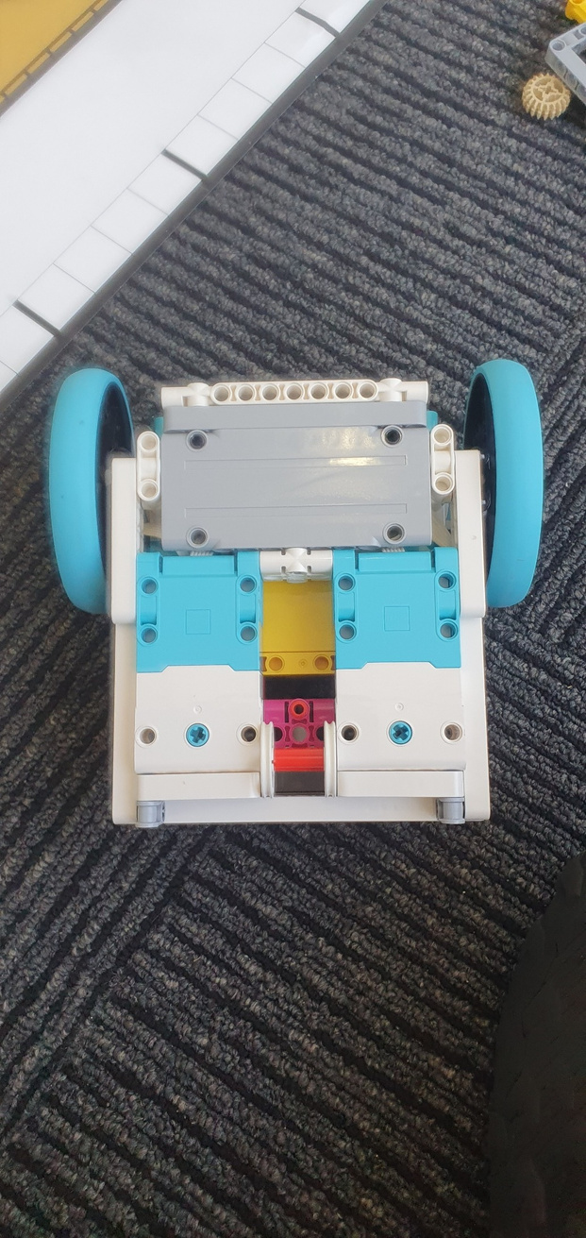
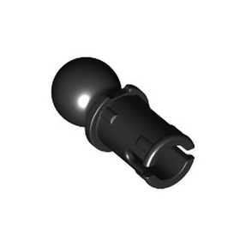
The Stability Wheel Issue
Issue: Stability wheel caused inaccuracies in movement.
Fix:
Came up with 3 possible solutions.
Non-Friction
Caster Ball
Plastic Nub ->
Tested them (turning and driving).
Determine which was best, ended up using non-friction wheels.
See page 10 of the Robot Design file
Notes:
One of our biggest issues in the past was where the stability wheel was causing inaccuracy in robot movement.
How we fixed it:
We came up with three different back wheels and put them through turning and driving tests to determine the best wheel to be used, which ended up being caster balls.

Slide 12
Part 3
Attachments

Slide 13
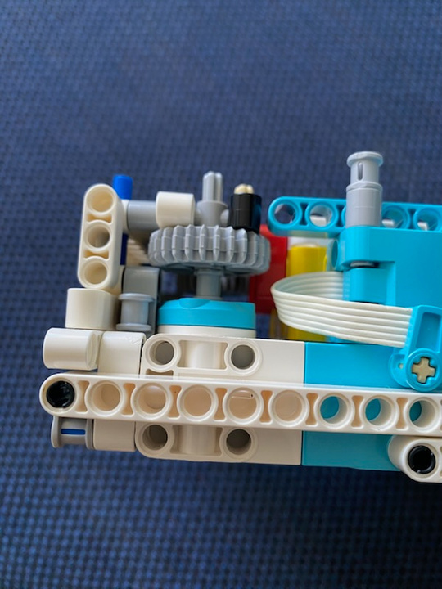
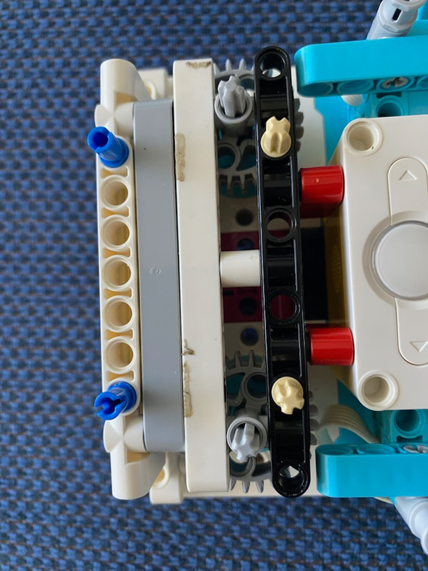
Motors
Attaches here
All our attachments are made on separate gearboxes and quickly attached to the motors on the top of the robot. This allows for efficient pit-stops in between runs.
See page 7 of the Robot Design file

Slide 14
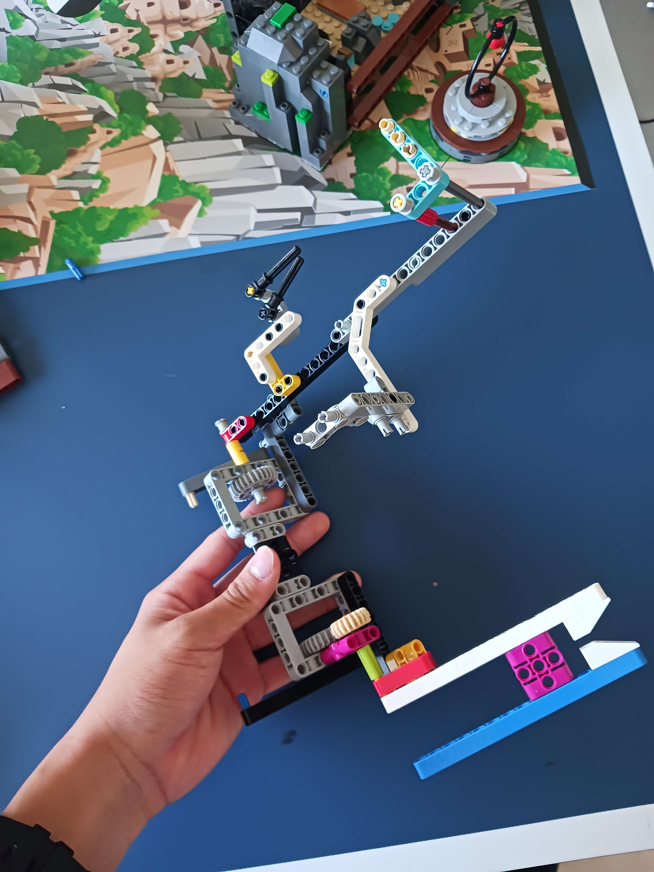
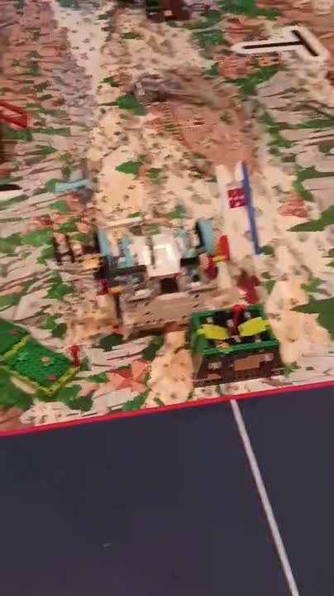
Attachment 1
See page 8 of the Robot Design file
This attachment is used for the missions surface brushing and map reveal.
Reliability
Functionalility

Slide 15
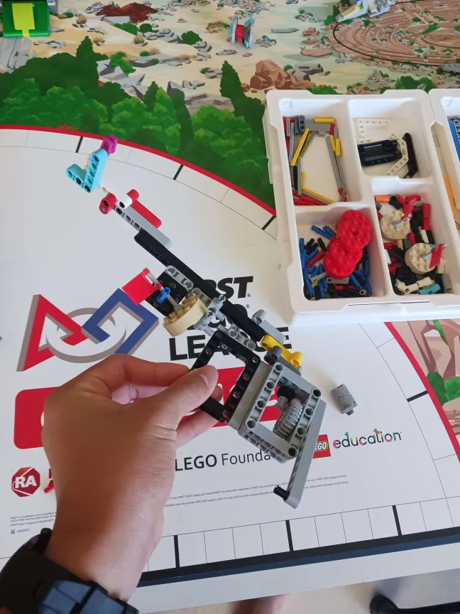
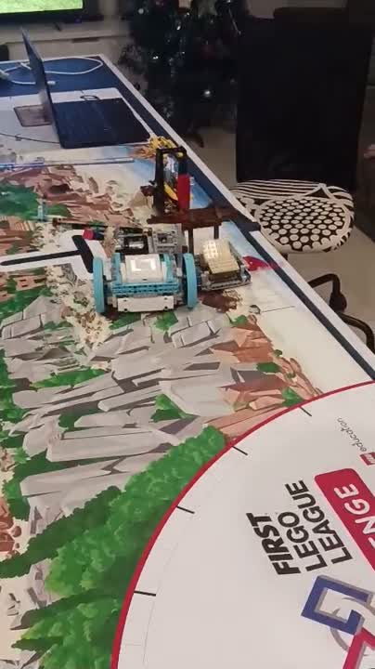
This attachment is used to complete salvage operation and a part of site marking.
Problem solving
Reliability
Attachment 2
See page 8 of the Robot Design file

Slide 16
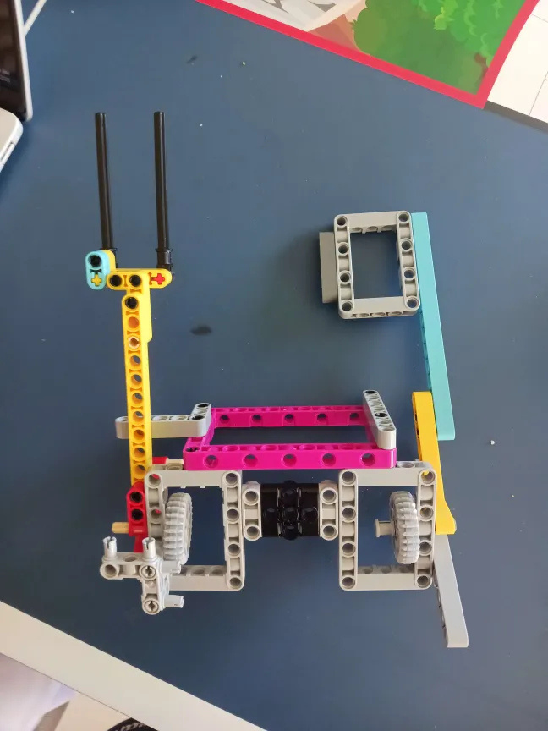
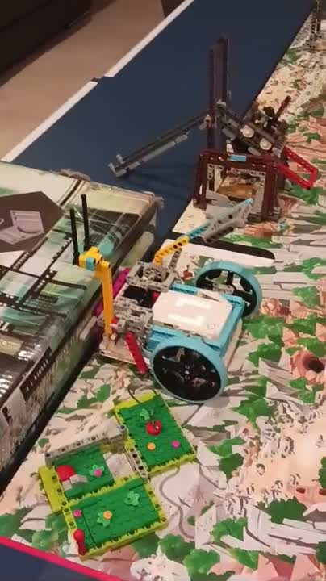
Attachment 3
See page 9 of the Robot Design file
This attachment is used to complete both components of the mineshaft explorer and careful recovery.
Efficiency
Simplicity

Slide 17
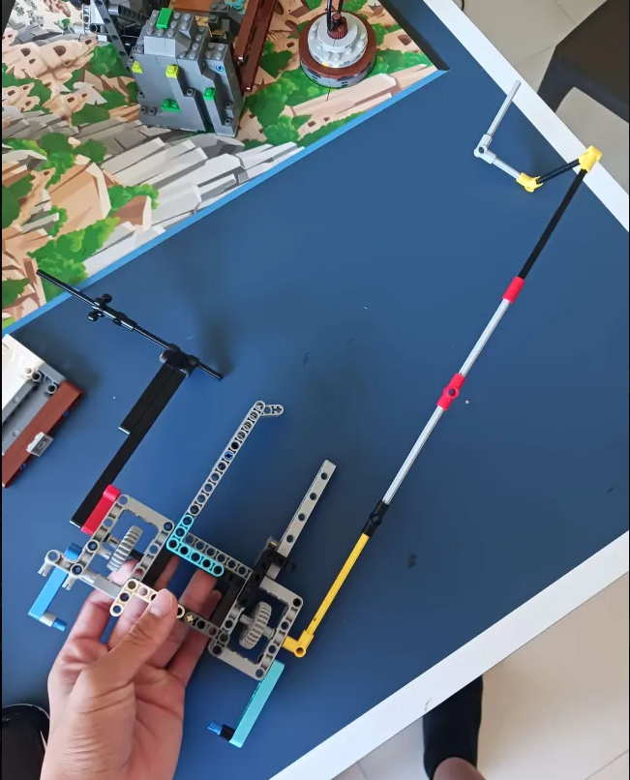
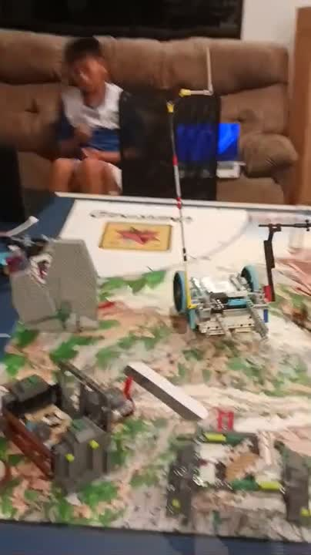
This attachment does a lot of missions including the forge, who lived here, raising the roof of the market, tip the scales and heavy lifting.
Efficiency
Maintainability
Attachment 4
See page 9 of the Robot Design file

Slide 18
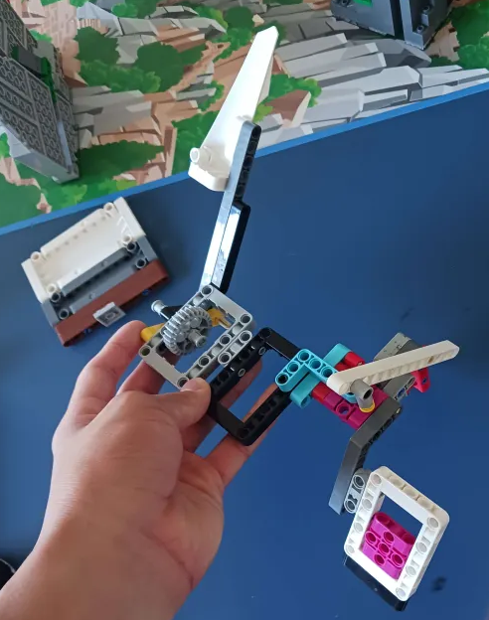
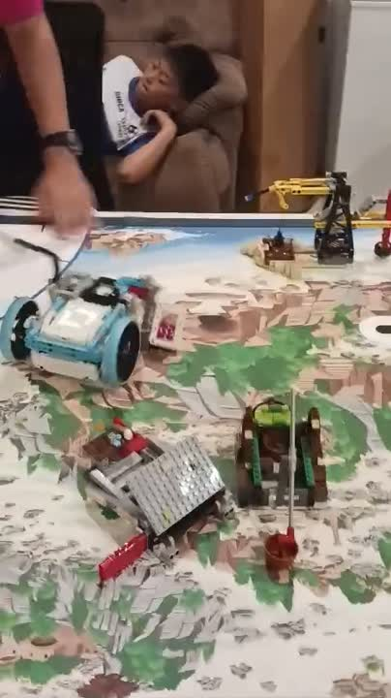
Attachment 5
See page 10 of the Robot Design file
This attachment does Statue Rebuild combined with a one way gate to passively pull out the scale pan.
Simplicity
Efficiency

Slide 19
Part 4
Programming

Slide 20
Code: What we Used
Programming Language: Python, PyBricks module.
Hub: Spike Prime.
Coding software: VSCode, PyCharm. Any IDE that supported python would work.
Learning python through FLL has helped us use python in school assignments.
See page 2 and 7 of the Robot Design file

Slide 21
Coding Resources
Grok Academy (https://groklearning.com/): Learnt basic Python on a course.
Python documentation (https://docs.python.org/3/): Includes basic information on how to program with Python, syntax, features, etc.
PyBricks documentation (https://docs.pybricks.com/en/stable/): Includes information about using micropython to control the hub, motors, movement functions, etc.
See page 2 of the Robot Design file
Notes:
School - We got everyone in our team to learn python from the python documentation and through other more experienced team members. Because we learnt it here it helps a lot with our school work as we have one major coding assignment every semester.
Other robotics - Some people do robotics in other places such as FRC with Curtin university and it can help code more complicated robots.

Slide 22
How our Code Works
Object Oriented Programming (Classes): Keep code organised.
Robot class handles motors, drive settings, gyrometer, moving arms, driving, turning.
PID class handles angle wrapping, better turning and calculations for a more accurate movement.
Mission control class handles the UI and allows us to pick which run using the buttons on the hub.
See page 13 of the Robot Design file
Notes:
We use multiple classes and helper systems to keep the robot code organised.
The Robot class handles all motors, drive settings, gyro control, and attachment logic.
Extra helpers manage PID driving, angle wrapping, speed profiles, and battery status.
This setup keeps our runs consistent, predictable, and easy to tune.

Slide 23
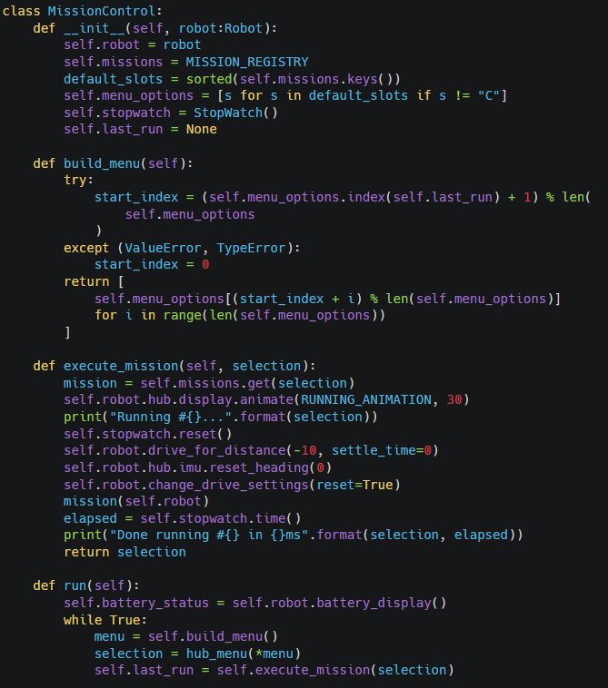
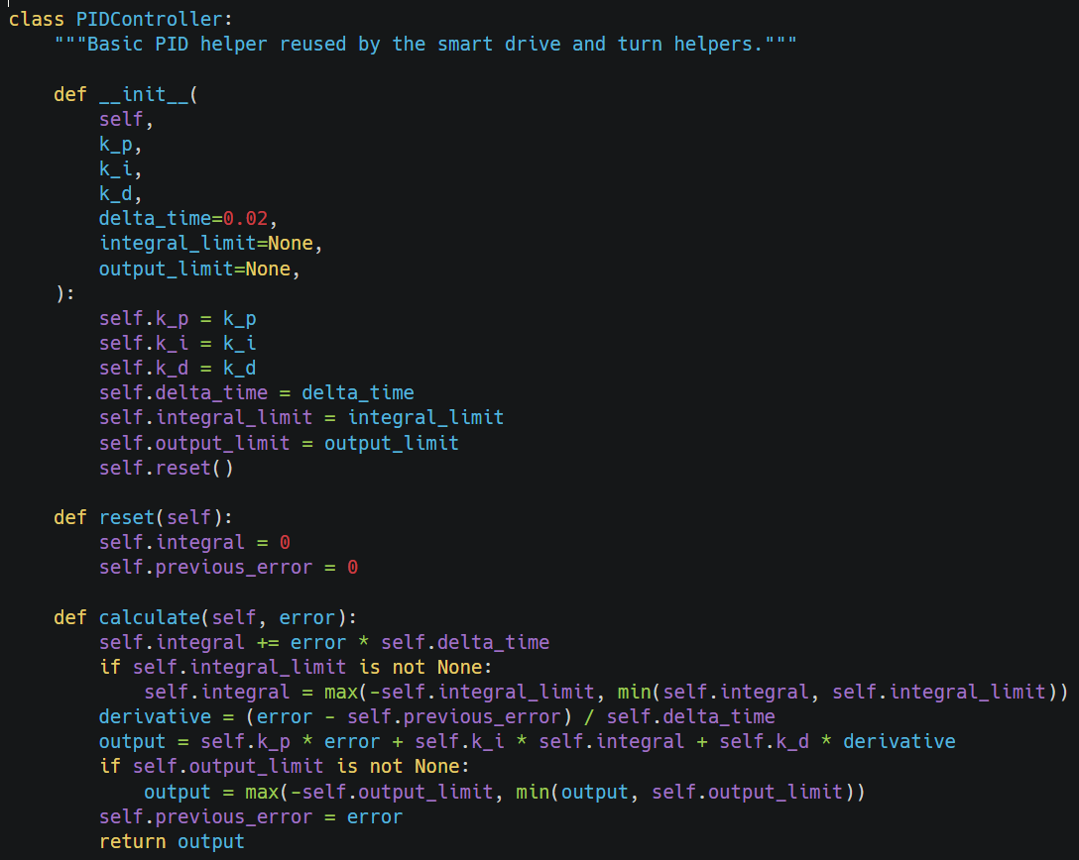
our code
See page 13 of the Robot Design file

Slide 24
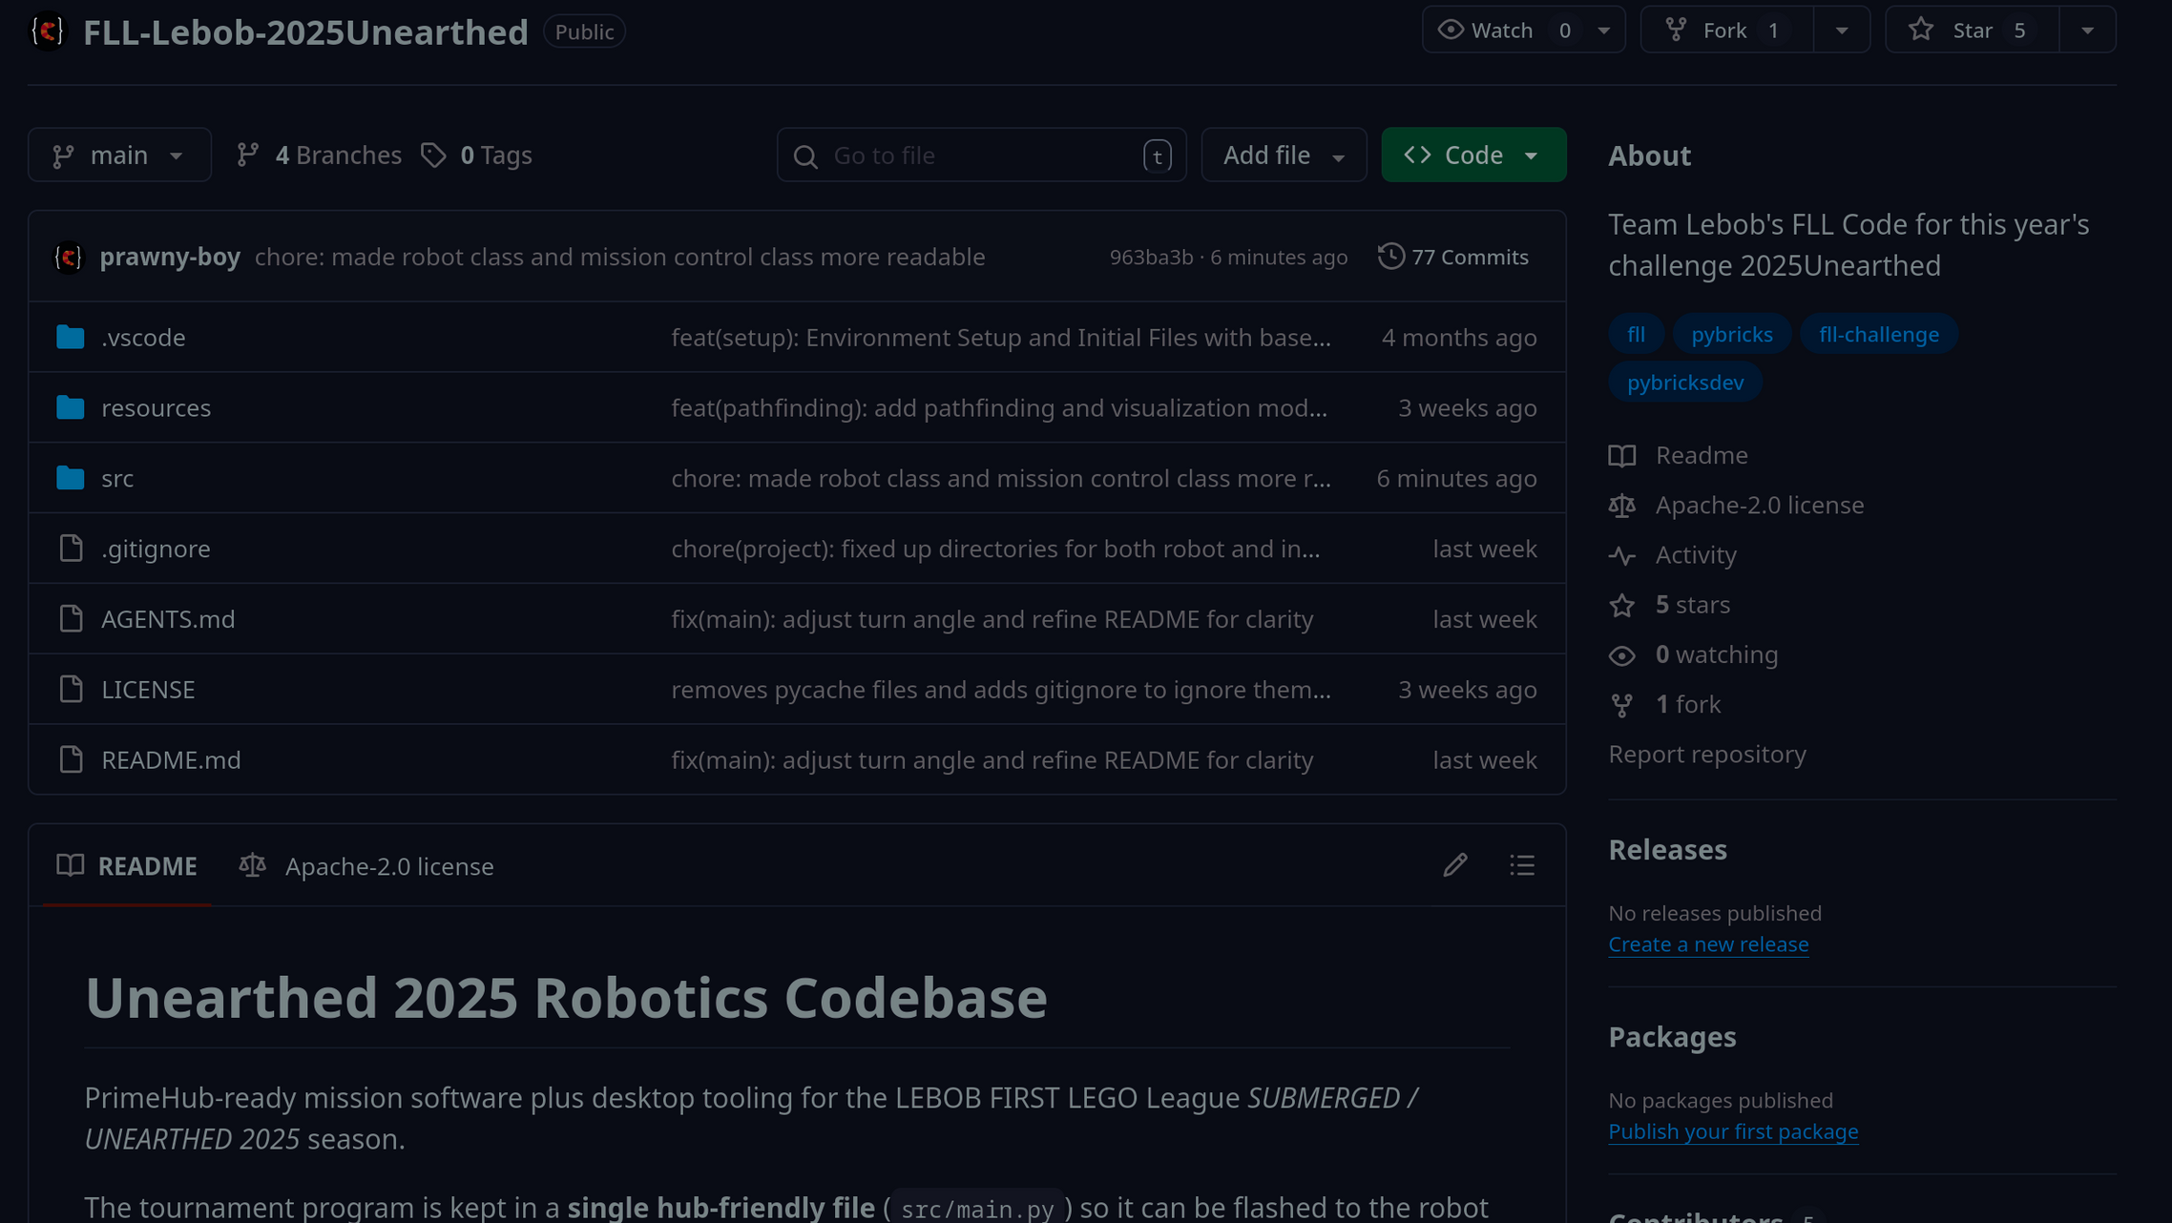
Github
We used GitHub to track changes and work on the code for both robot and innovations at the same time.
This meant the whole team could contribute. This made our coding faster, easy easier to collaborate on.
Commit messages let us see what changed, who changed it, and rollback if needed.
See page 15-16 of the Robot Design file

Slide 25
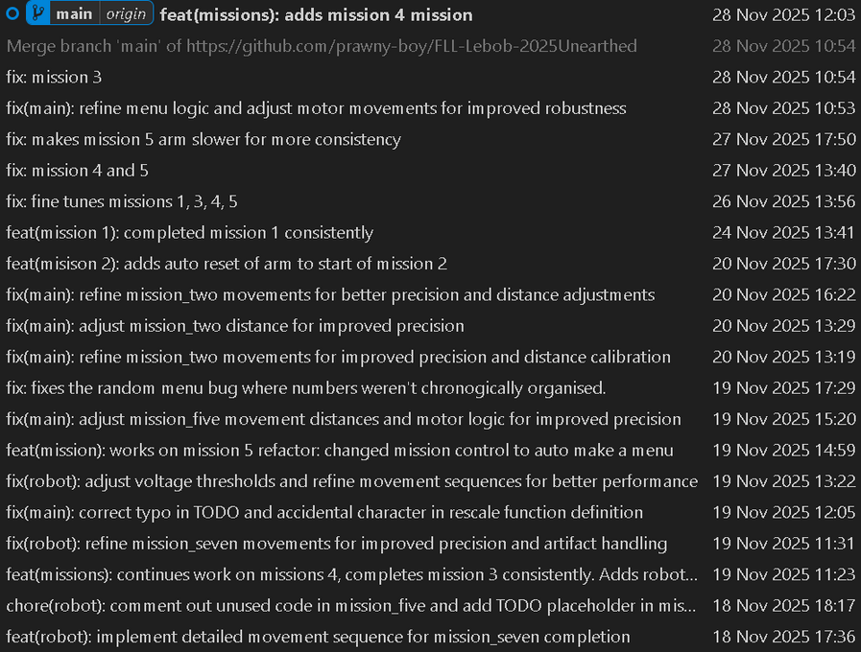
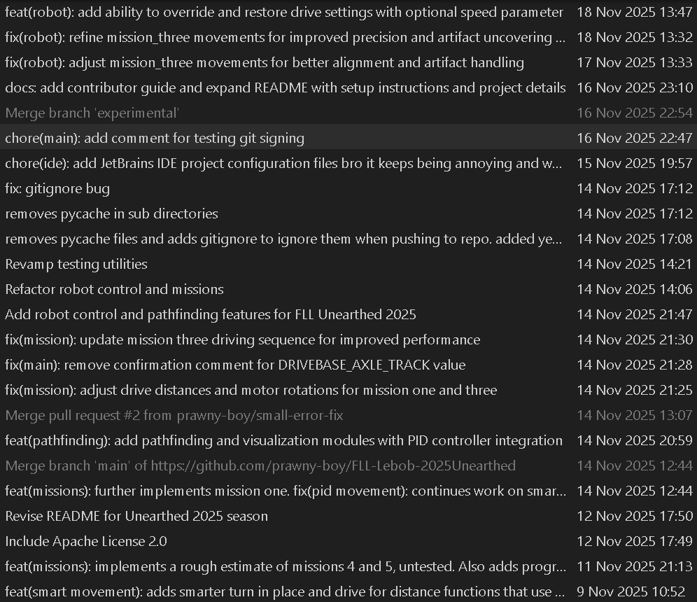
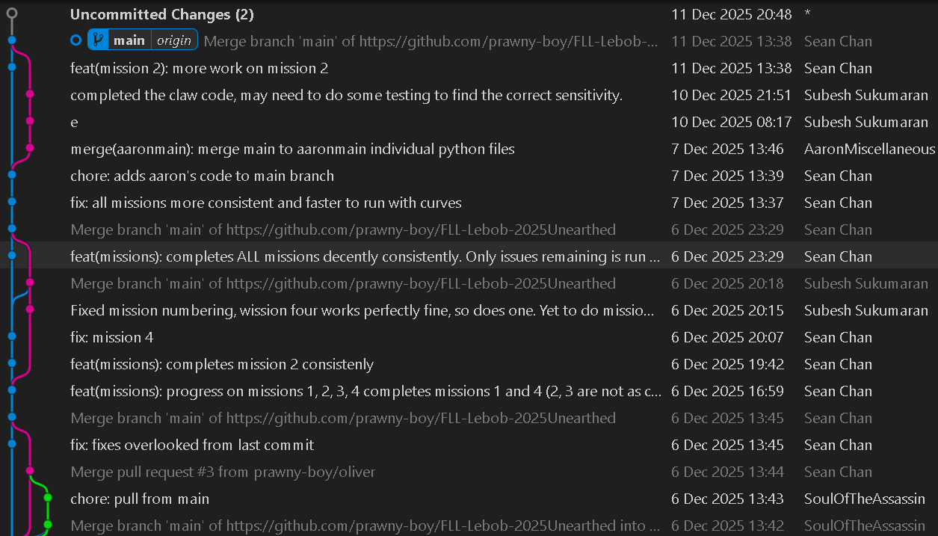
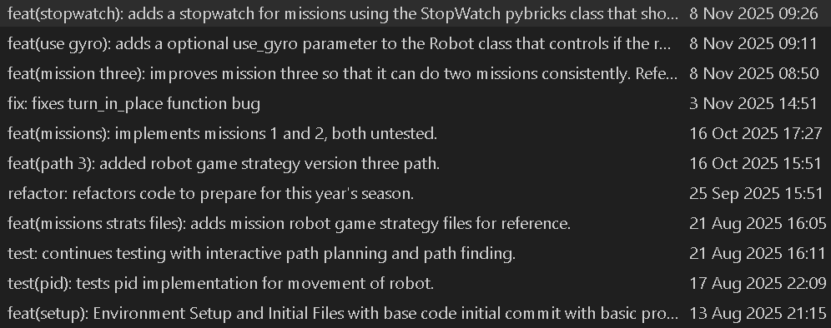
See page 15-16 of the Robot Design file

Slide 26
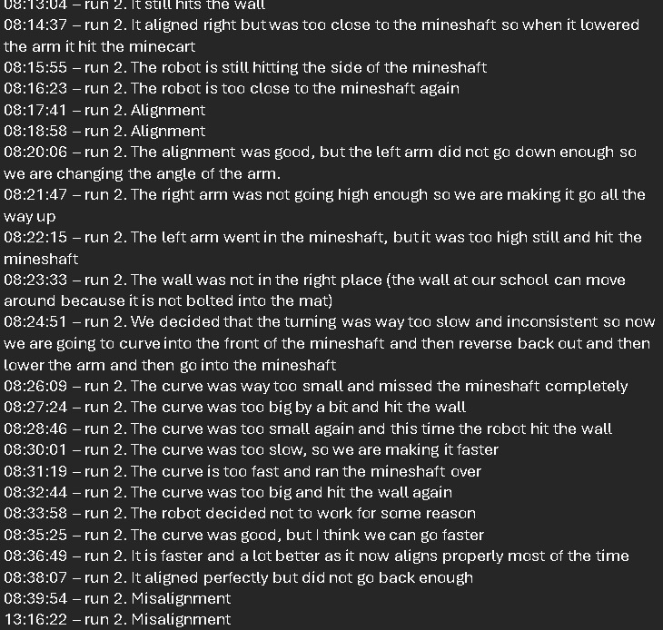
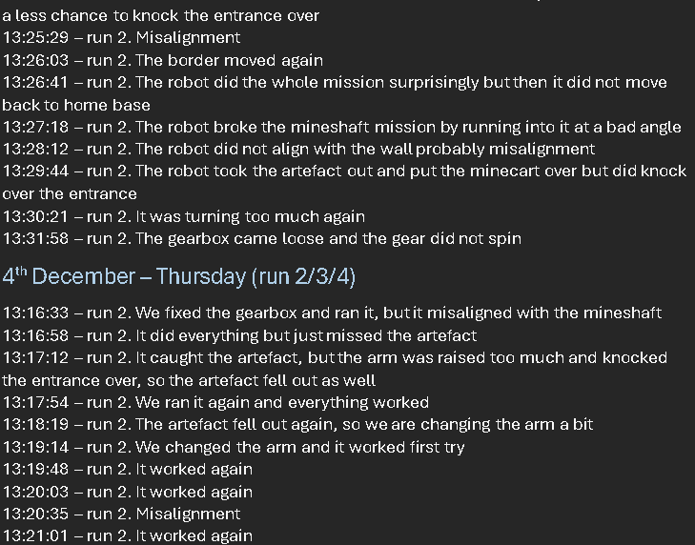
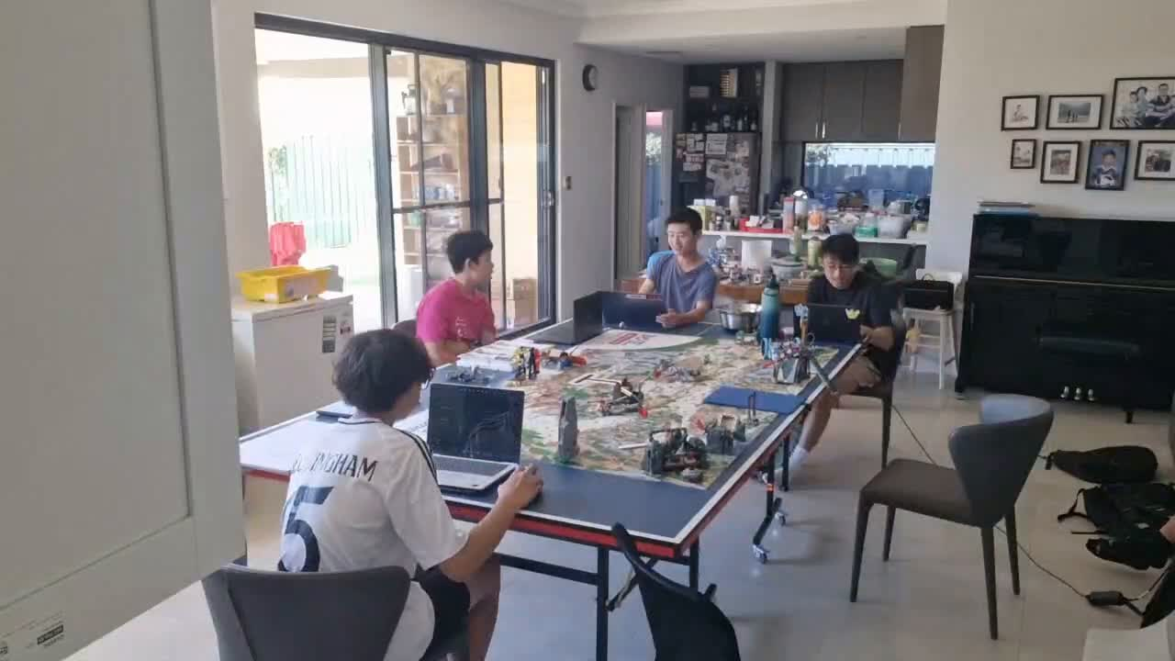
Proof of Iteration
As we iterated on code and mechanisms for robot design, we made many logs about what happened each time we ran the robot.
E.g. 13:16:33 – run 2. We fixed the gearbox and ran it, but it misaligned with the mineshaft
Timelapse is running as we speak
See page 15-16 of the Robot Design file See page 13-28 of the Documentation file

Slide 27
Part 5
Things we learnt

Slide 28
lessons learned
Working Together
Division of Work
Gracious Professionalism
Healthy Work Environment
See page 17 of the Robot Design file

Slide 29
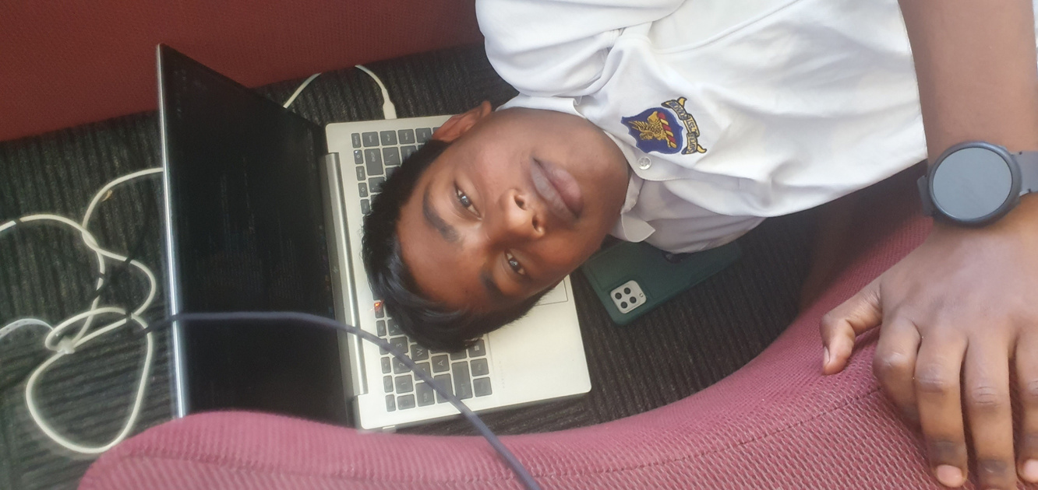
lessons learned continued
Some important lessons we learned from last year:
No big changes
Documentation
Communication
Organisation
See page 15 of the Robot Design file
Notes:
We also used things and lessons we learnt from last year:
Robot problems - Last year, we didn’t do very well at nationals for the robot game because we changed the whole robot and didn’t have enough time to code it so this year we decided to change the path of the robot instead of changing the robot which allowed us to code the game in time.
Another problem was the fact that we did not have enough proof of progressive testing but now we have a logbook that is in the documentation
Communication - Last year we found that communicating was really hard especially through emails so this year we decided to have a whatsapp group chat and a discord group chat where we can talk and send photos, videos and communicate. Our Discord group has anouncement, general, programming, mechanical, innovations and a pictures group as well as a voice chat for calls.

Slide 30
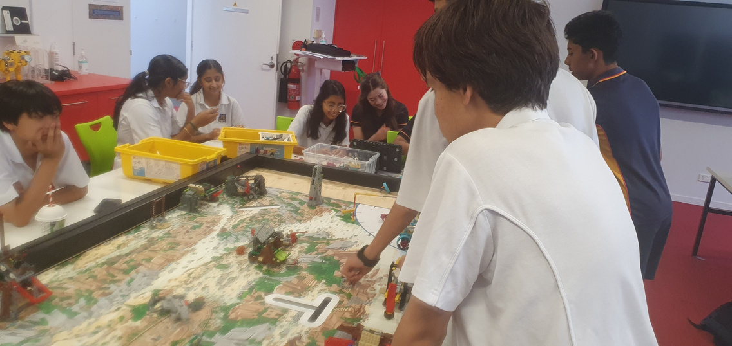
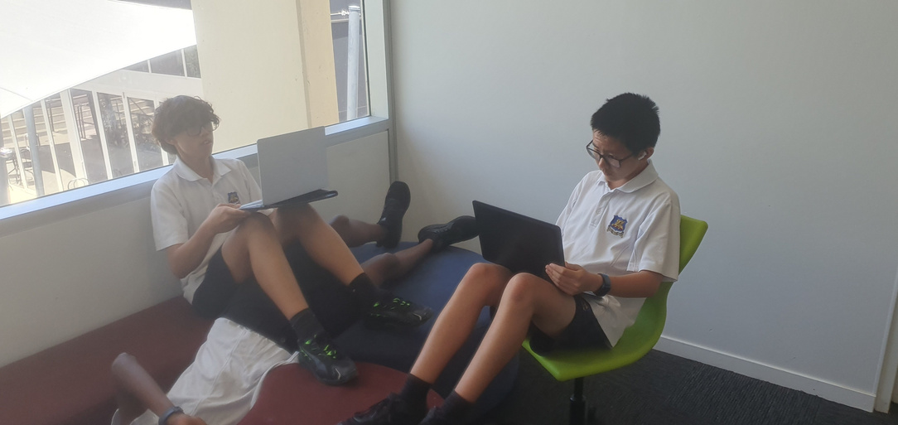
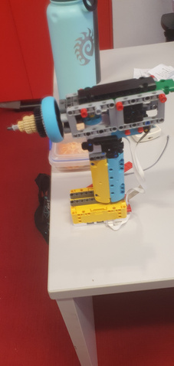
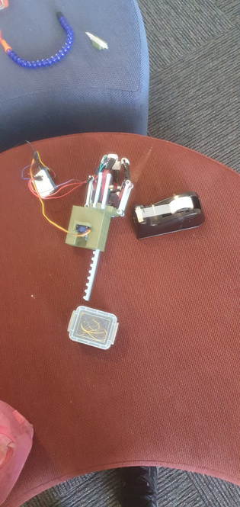
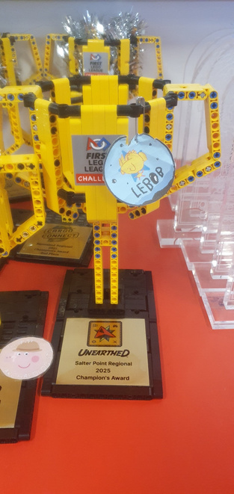
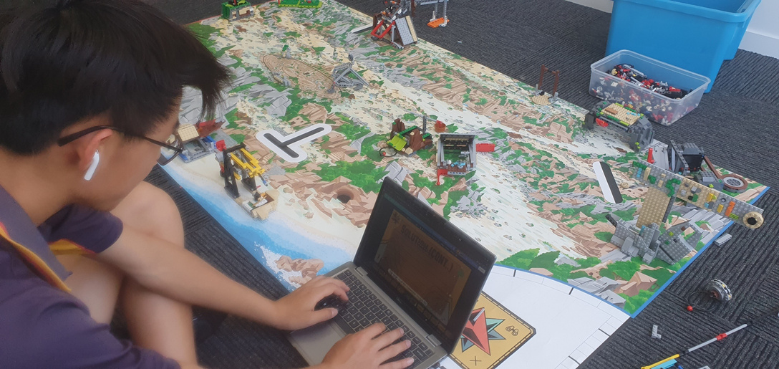
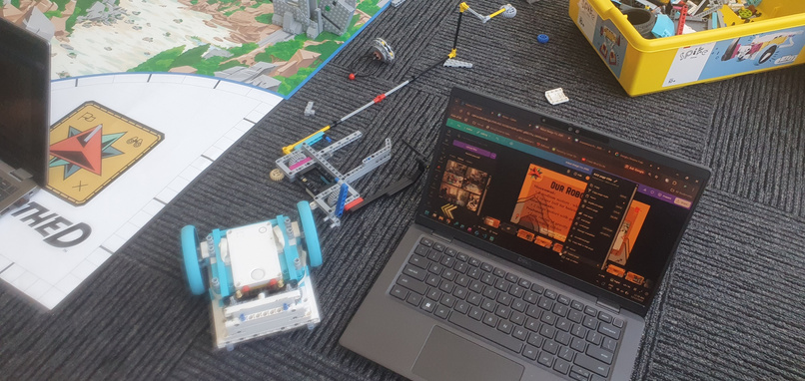

Thanks for listening!
Lebob 2025
Notes:
We also used things and lessons we learnt from last year:
Robot problems - Last year, we didn’t do very well at nationals for the robot game because we changed the whole robot and didn’t have enough time to code it so this year we decided to change the path of the robot instead of changing the robot which allowed us to code the game in time.
Another problem was the fact that we did not have enough proof of progressive testing but now we have a logbook that is in the documentation
Communication - Last year we found that communicating was really hard especially through emails so this year we decided to have a whatsapp group chat and a discord group chat where we can talk and send photos, videos and communicate. Our Discord group has anouncement, general, programming, mechanical, innovations and a pictures group as well as a voice chat for calls.

Slide 31
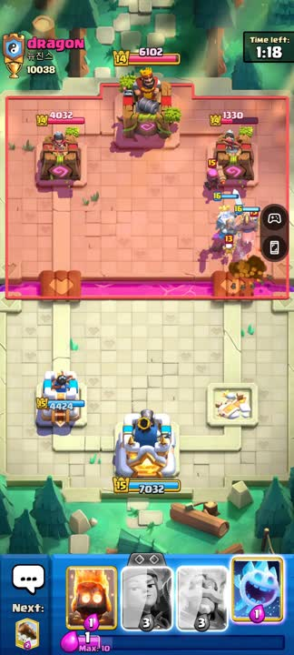
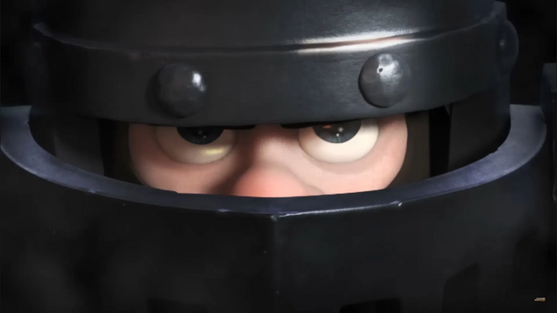

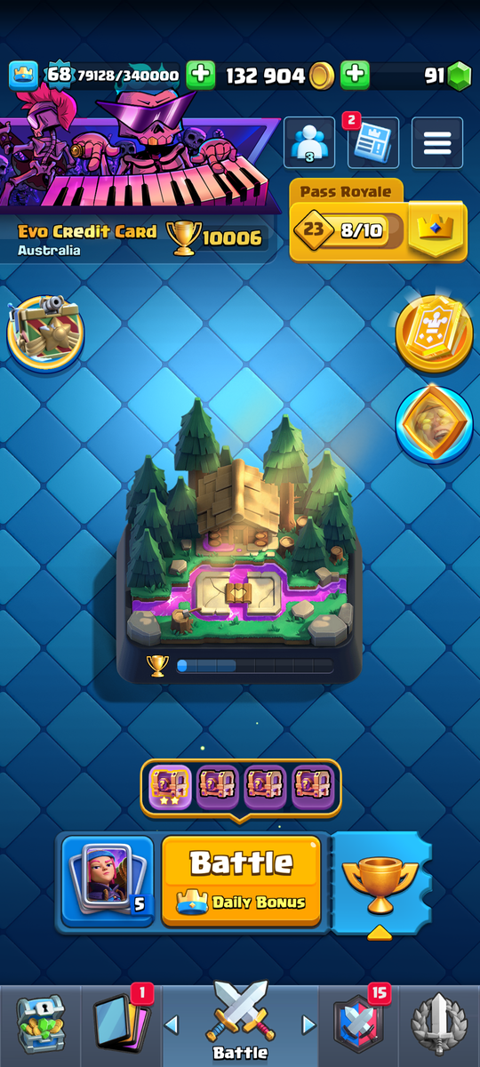
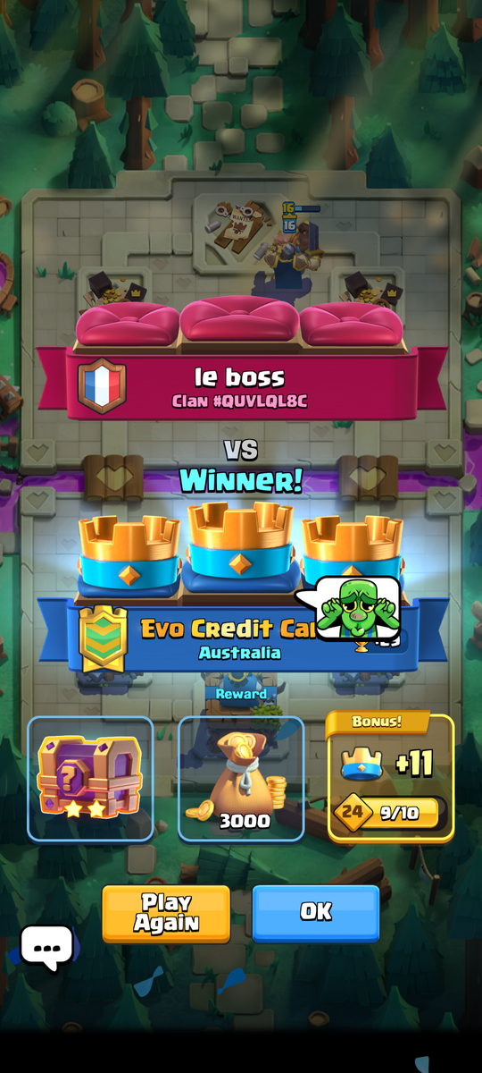


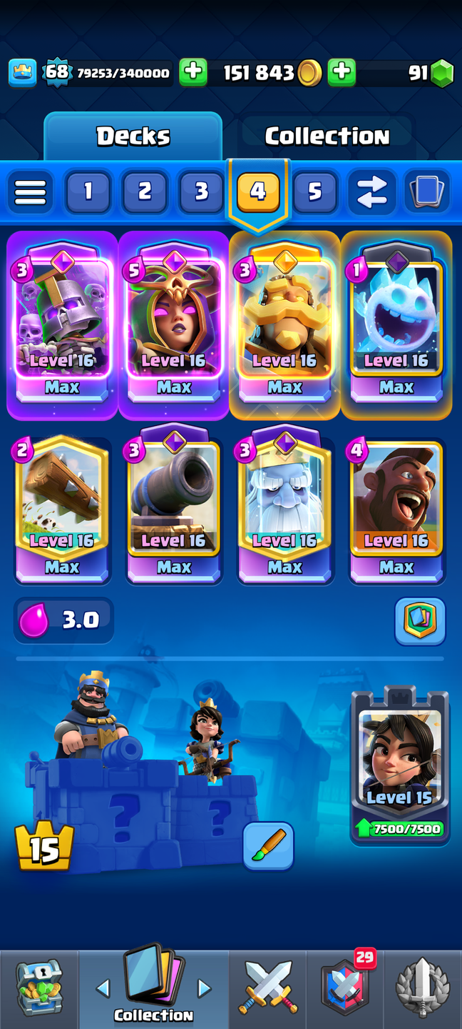



10k
THIS IS WHY WE CLASH
not pay to win guys

